Slide 1
Smart Devices Website by Ralph Abou Jaoude Christopher Chalhoub

Slide 2
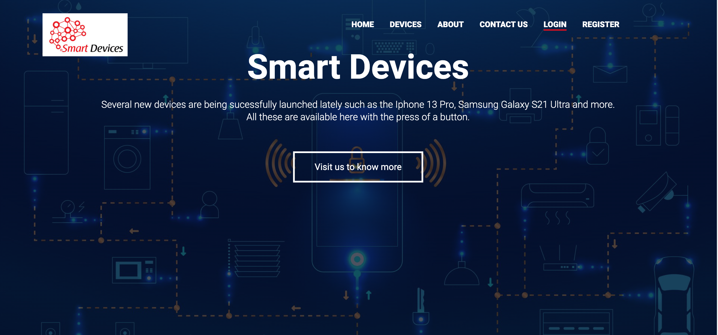
introduction
This website aims to provide the user with the most optimal experience.
The clients are provided with the best support and a variety of choices to cater for their needs.
The main features that are provided are: 360-degree view for the products, an online chat support with an admin, and a recommendation system for the user.

Slide 3
Tools
Html/css
Node js
Ejs
mongoDB
Socket.io

Slide 4
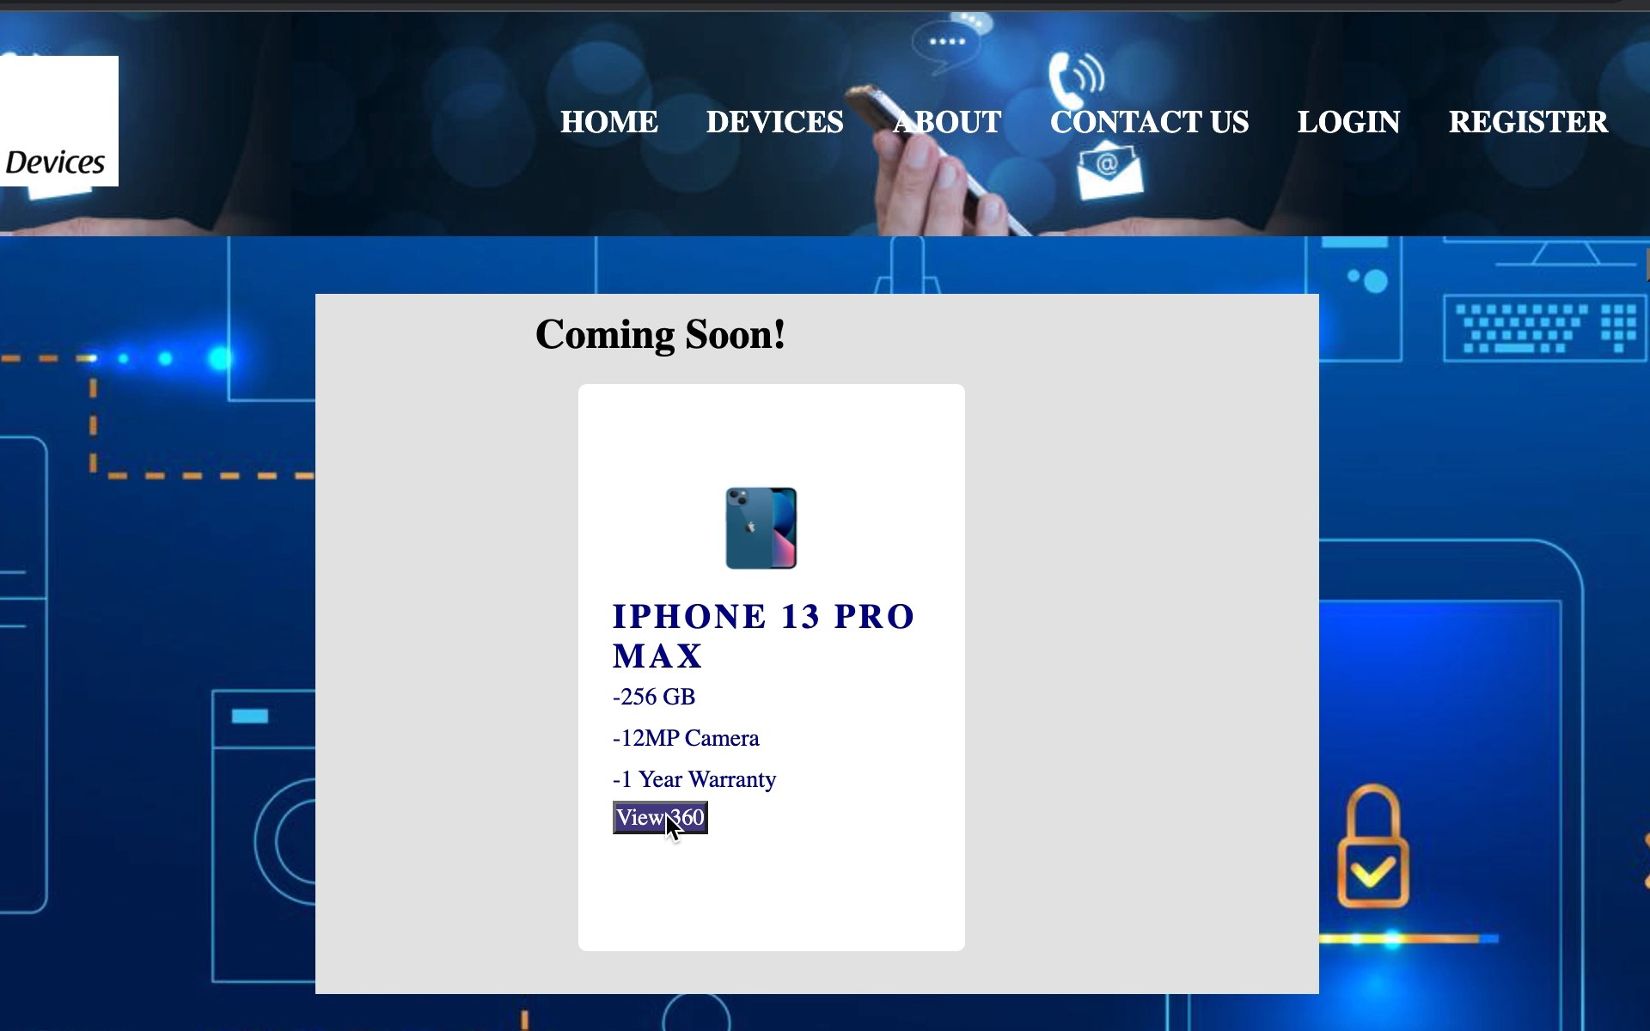
360 degree view
The user can inspect the device by clicking on the “view 360” button, then a page pops up where he is able to drag the device left or right to check all the angles of the device.

Slide 5
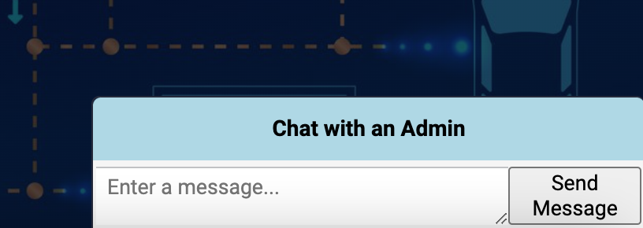
Chat support
If the user requires immediate assistance, by pressing “chat with an admin” button he is able to live chat with an admin in order to resolve any issues or inquiries that he has.
In order for the admin and the user to communicate together, we used sockets which are composed of two parts: a server and a client.

Slide 6
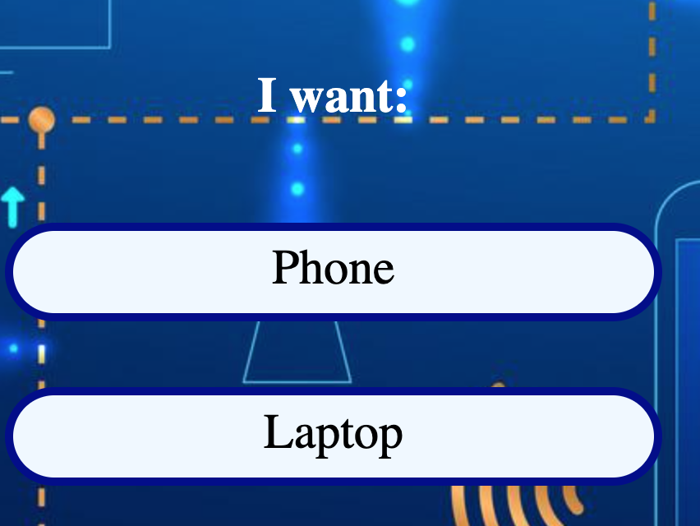
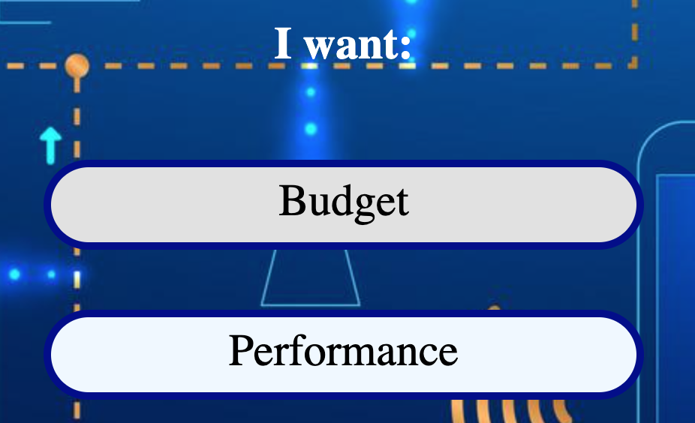
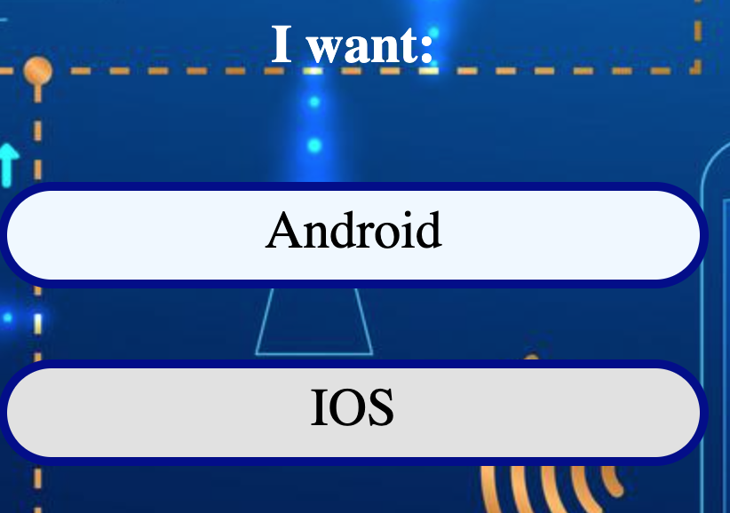
recommendations
The user can get a recommendation where he is asked three consecutive questions about certain specification of the devices that he is looking for.
For instance, the user can choose a Phone or a Laptop, then according to the first choice, he is given two following questions to choose between certain specifications.

Slide 7
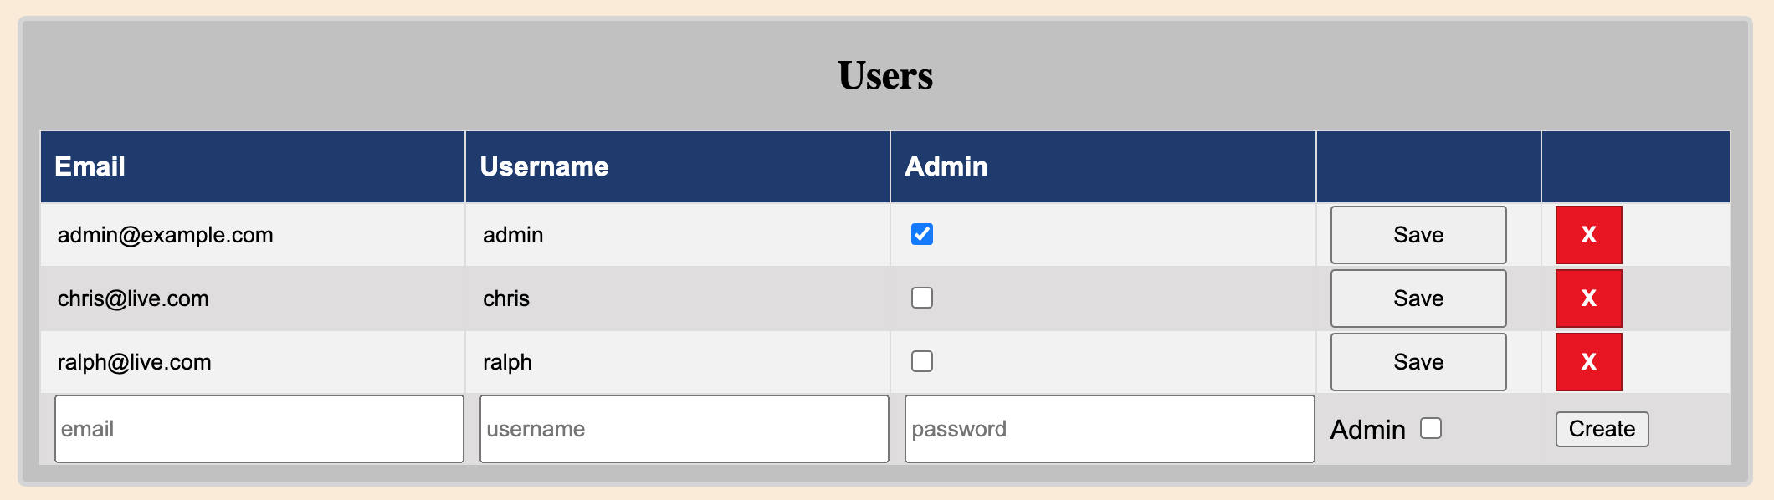
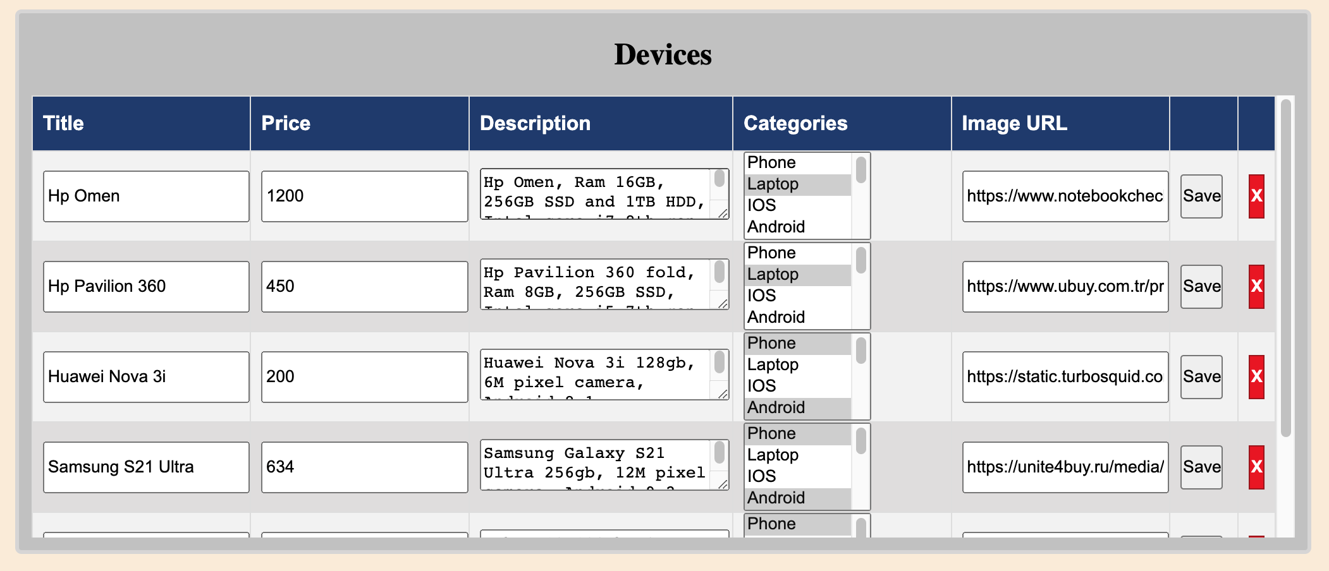
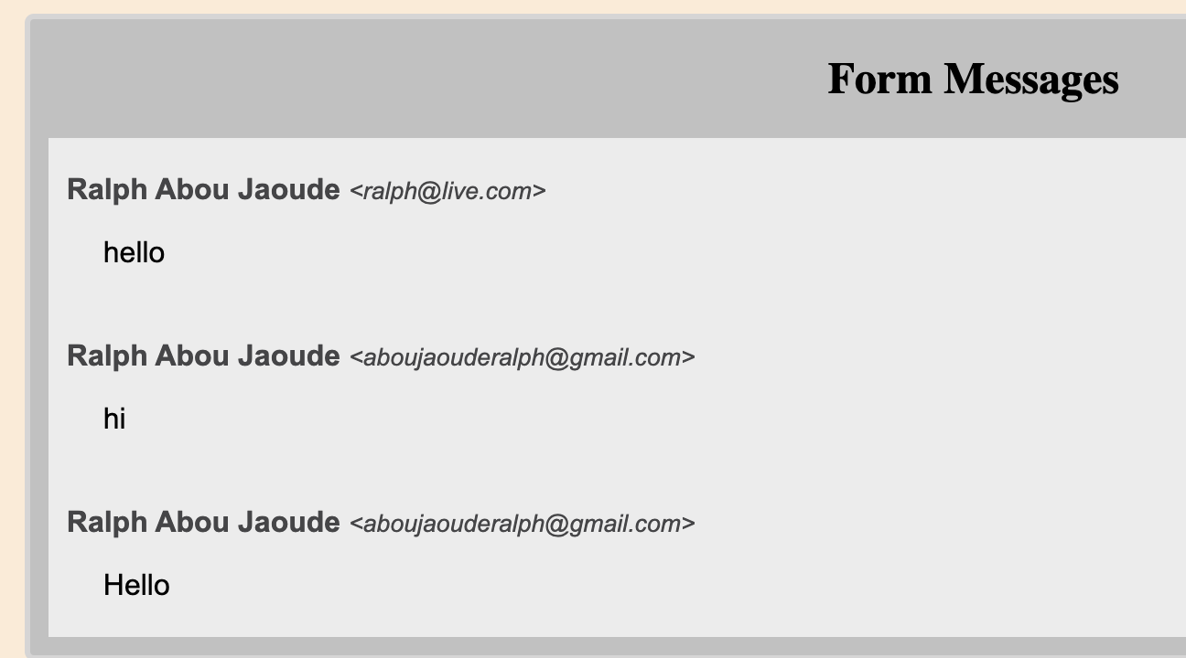
Admin panel
In the admin panel, the admin can add, delete, and edit a user or a device.
He can also view the messages sent through the contact us page and reply to a user by an email.

Slide 8
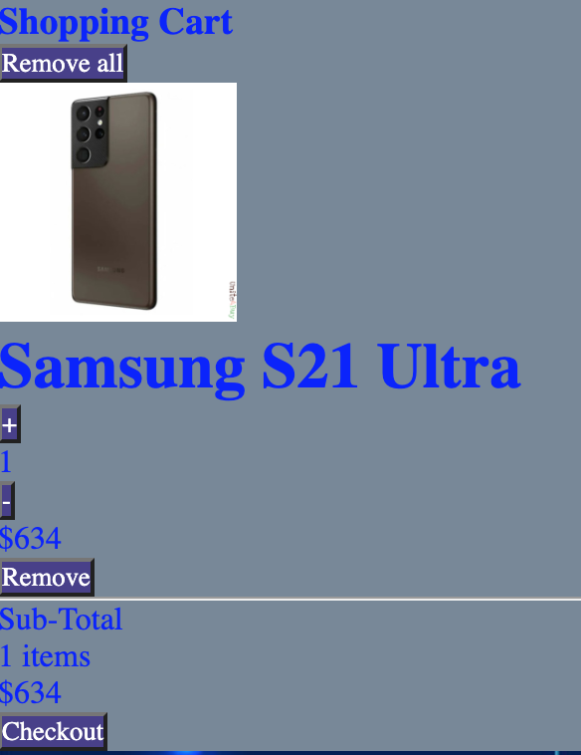
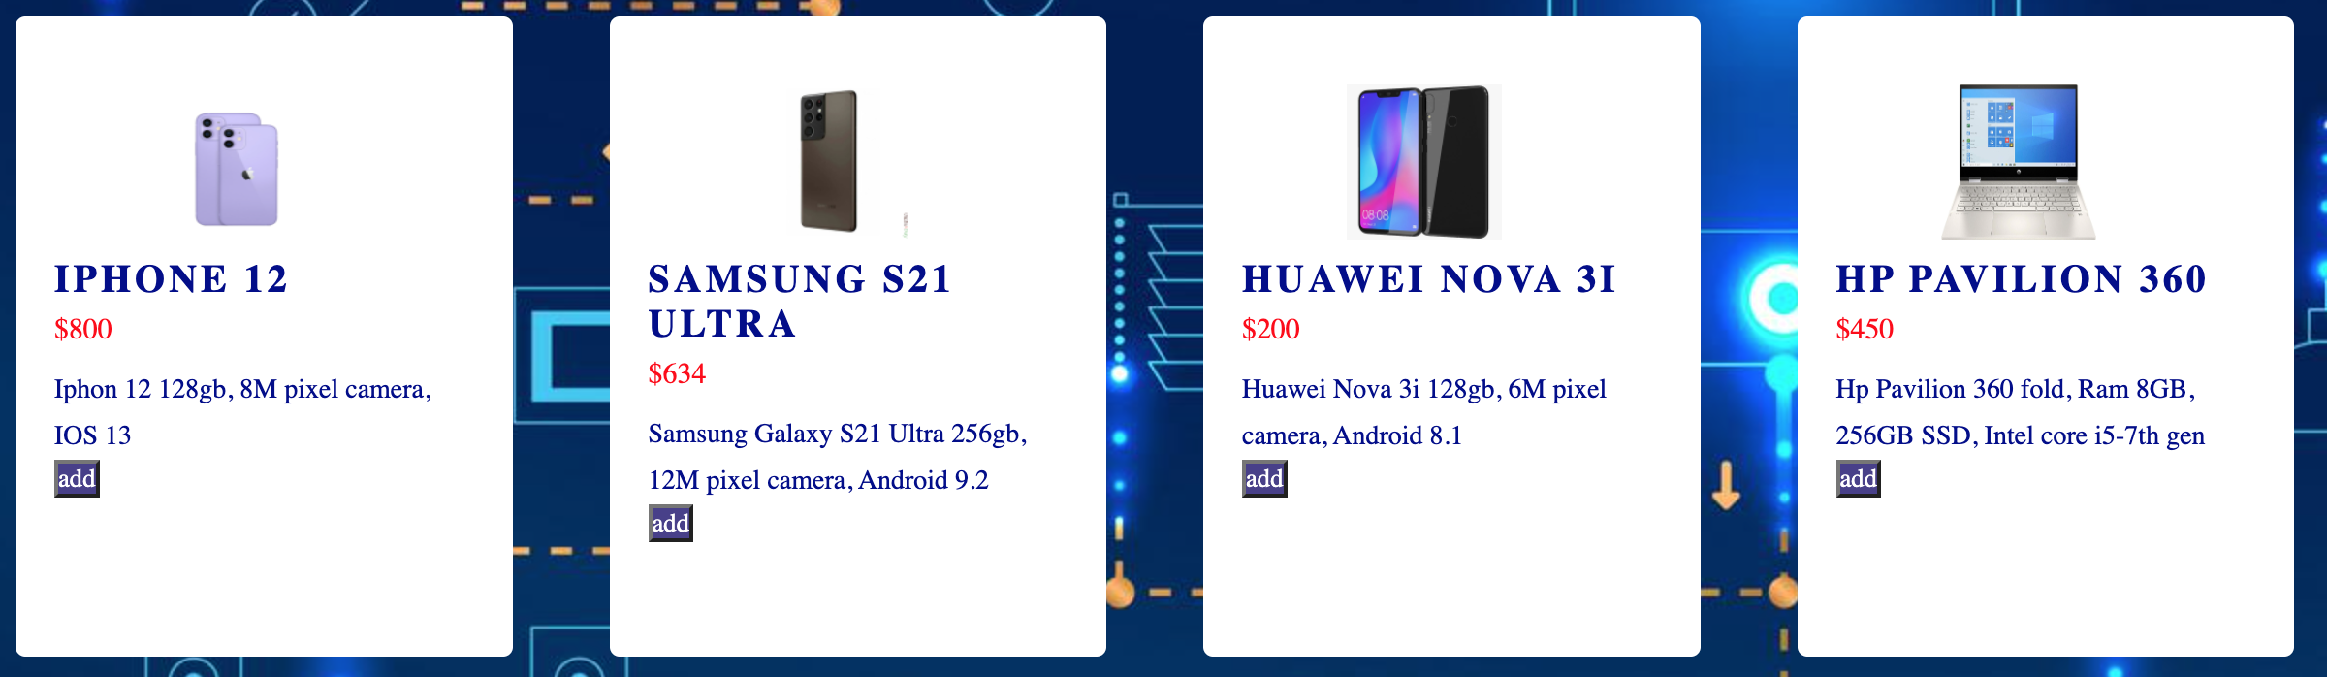
Shopping cart
Devices

Slide 9
Thank you ☺

